Slide 1

Mathero
Mathero
Success is no accident. It is hard work, perseverance, learning, studying, sacrifice and most of all, love of what you are doing or learning to do.
Start

Slide 2

Welcome to MATHERO
Team Enjoy
A virtual learning environment
beyond your imagination.
Team Enjoy
Gamification in eLearning has become increasingly popular since it offers a wide range of advantages for learners and can help to make the overall eLearning experience more enjoyable and effective. Mathero presents to you an innovative solution that transforms your eLearning experience.
Read more

Slide 3
Table of Contents
About Mathero
Key Features
Product Demo
Use Cases
Software
Architectures

Slide 4
Key
Features

Slide 5




Selling Points
Gamified eLearning
Fun and interactive online learning process to improve knowledge absorption & retention
Customized Quizzes
Generate creative quizzes and invite your friend to beat the challenge
Real-Time Player Collaboration
Collaborative learning environment to build trust and develop social skills

Slide 6
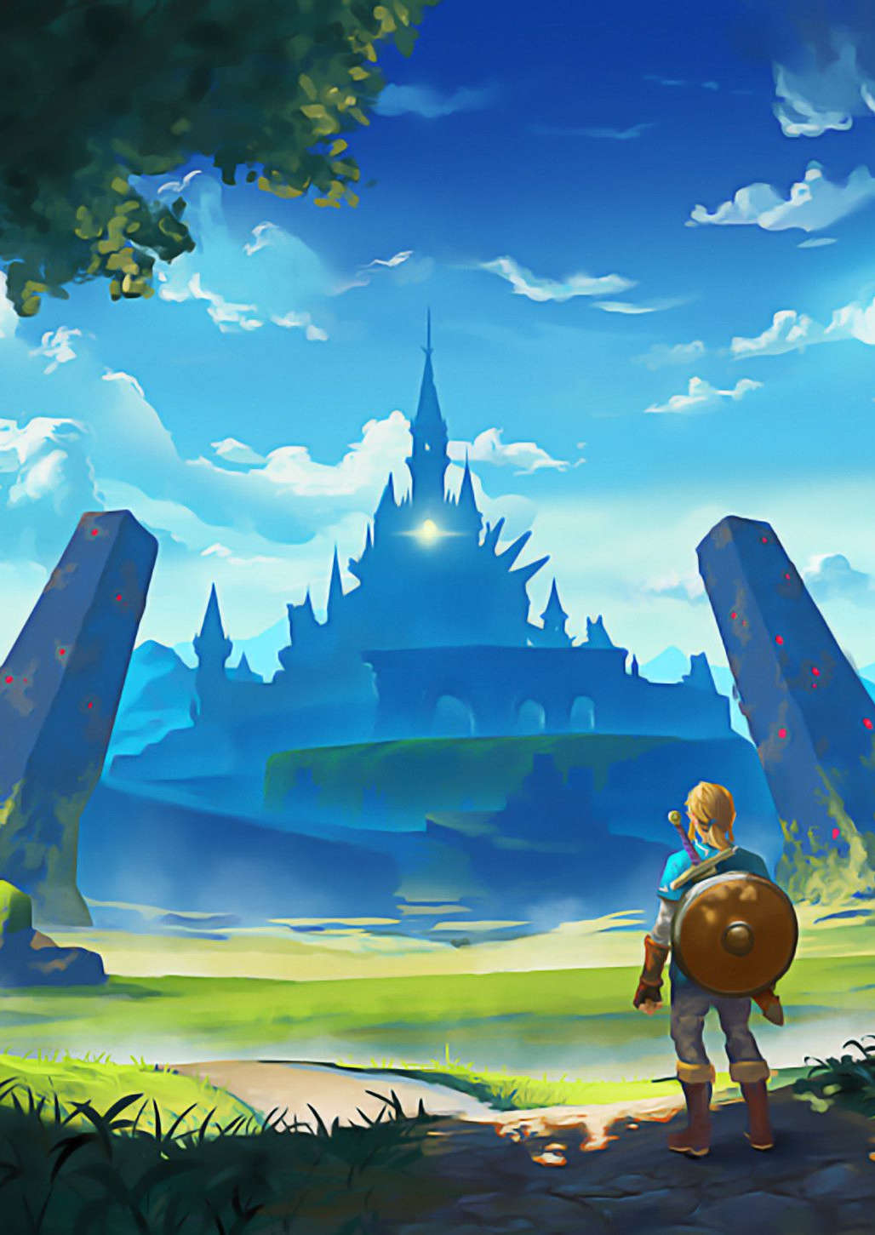
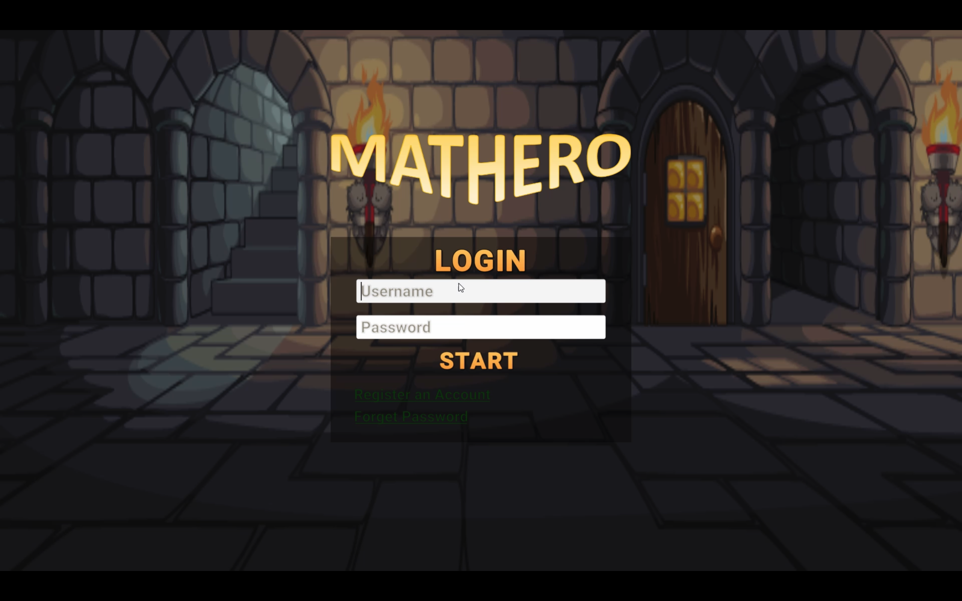
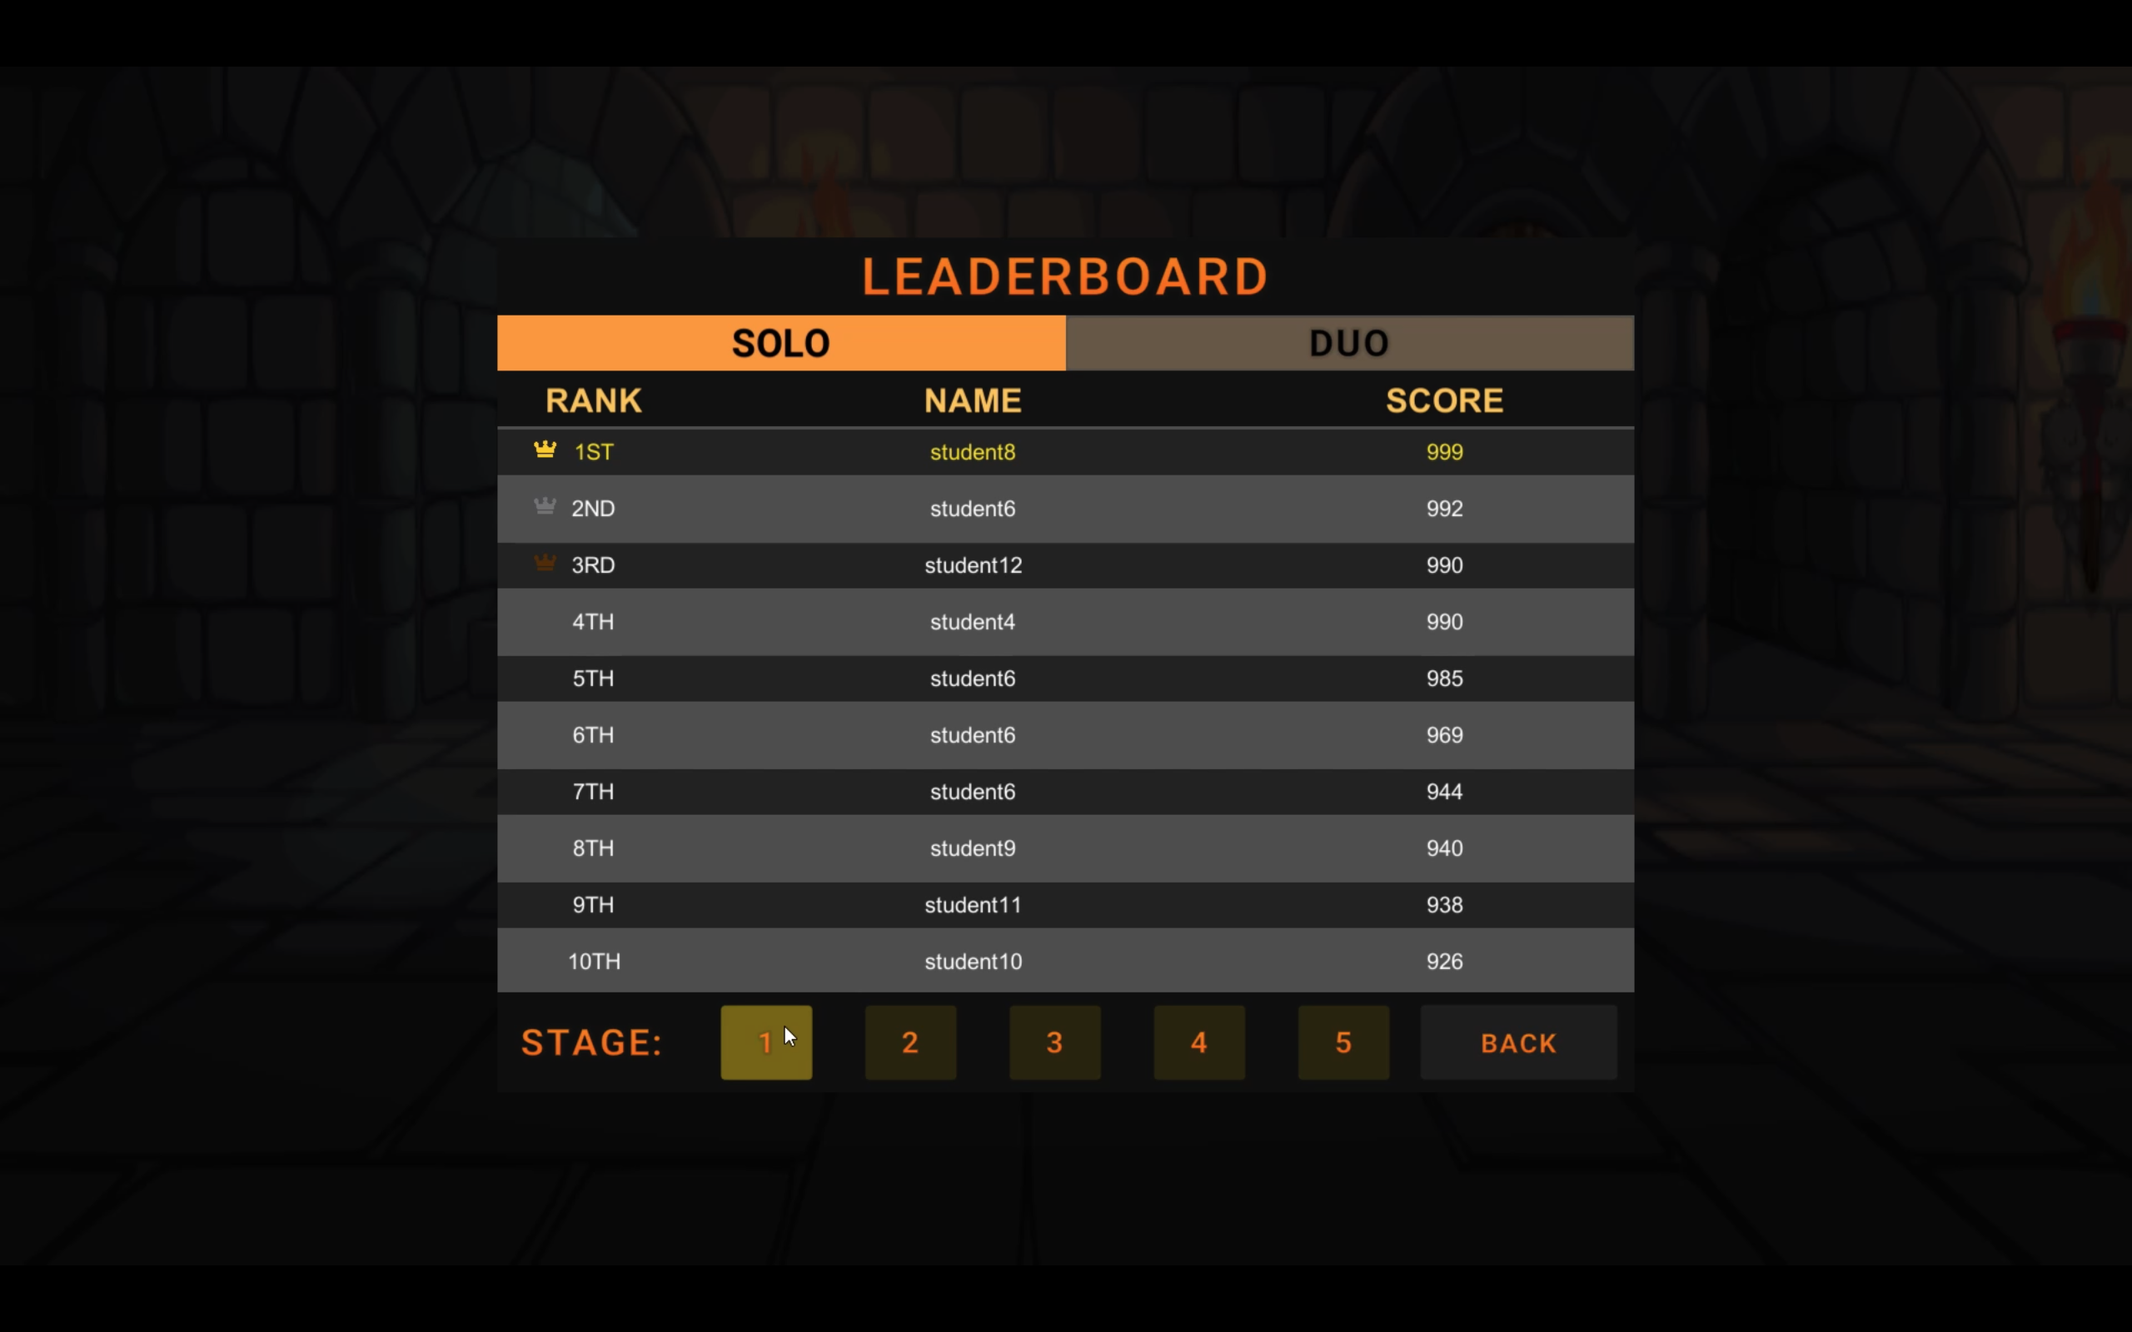
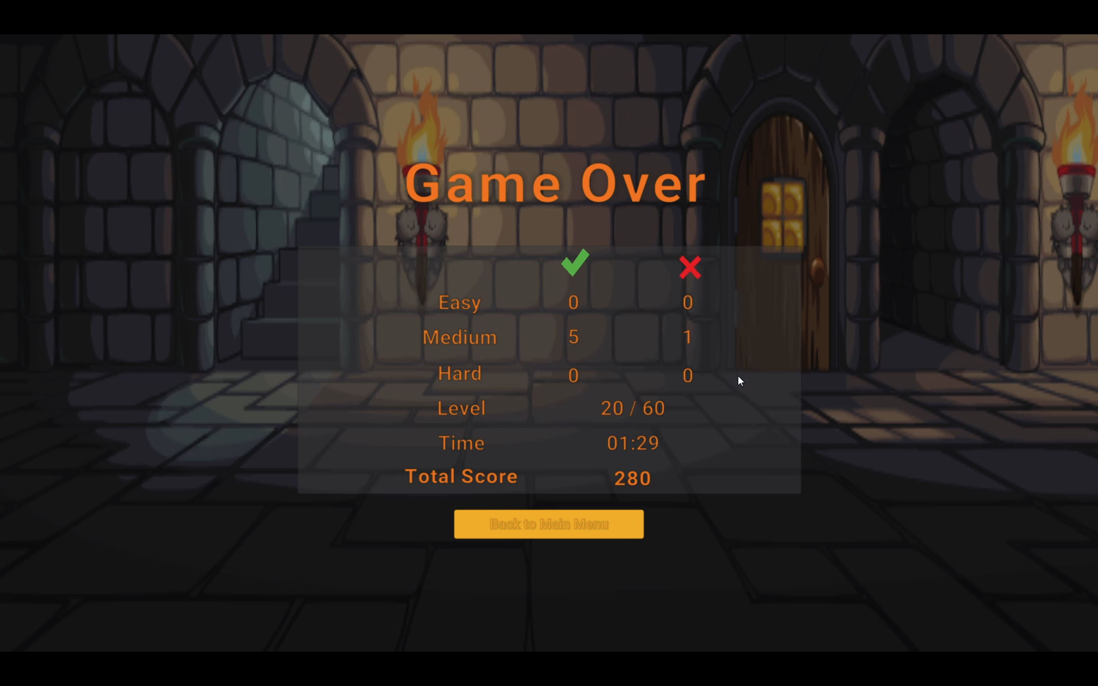
UI Design
Heart of Perfect Gamified eLearning.
eLearning delivers education virtually. Gaming exists to test the limits of our imagination. The combination of both makes gaming informative at the same time creates a fun and interactive learning process.
User Login
Leaderboard
Game Progress
6

Slide 7
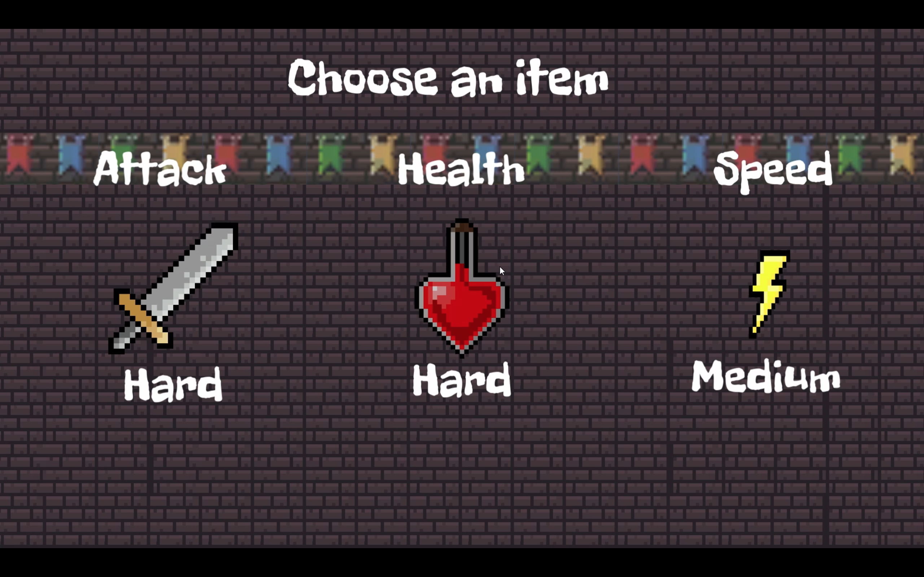
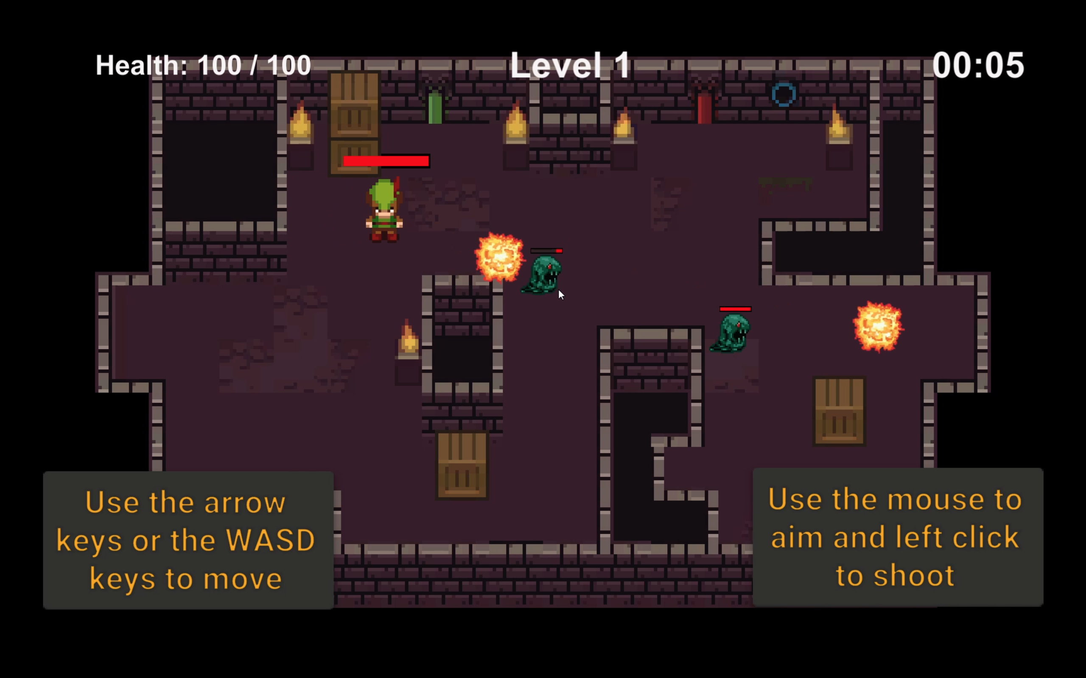
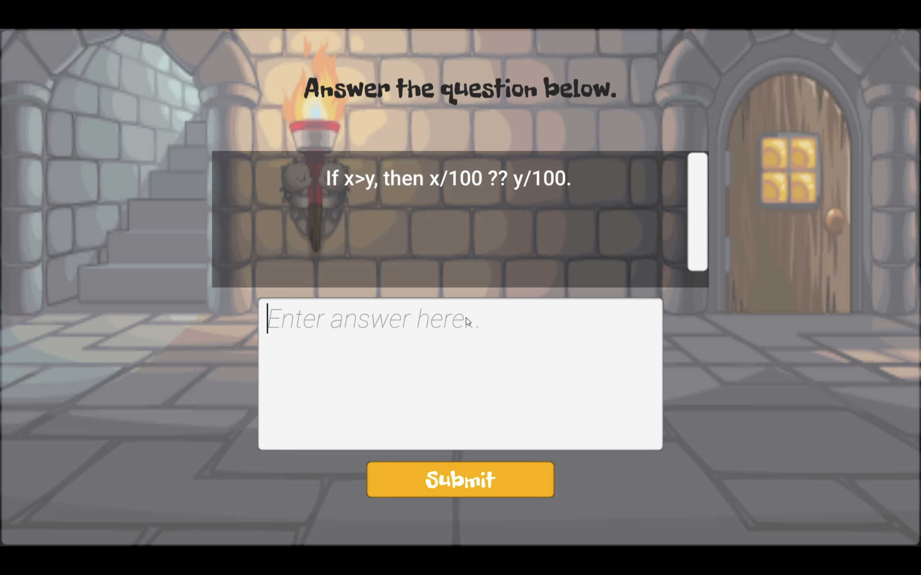
UI Design
Featured
Item Selection
Player Scene
Question & Answer

Slide 8
Use
Cases

Slide 9
Use Case
Create Custom Quiz
Create customized questions and share it with other students.
Case 01
Case 03
Play Game
Case 02
View Report
Check learning progress by viewing the summarized game completion report .
Illustrate the process of getting through each stage.

Slide 10




Story Flow
How does
it work?
Our game consists of two player modes : single and duo.
The question comes in three levels of difficulty : easy, medium and hard.
Items are used for getting : increase attacks, increase health and increase speed
Upon clearing of a stage, mark will be given based on the questions are answered correctly, may vary with difficulty level.
Select Player Mode
Defeat All Enemies
Pick An Item
Answer Quiz

Slide 11
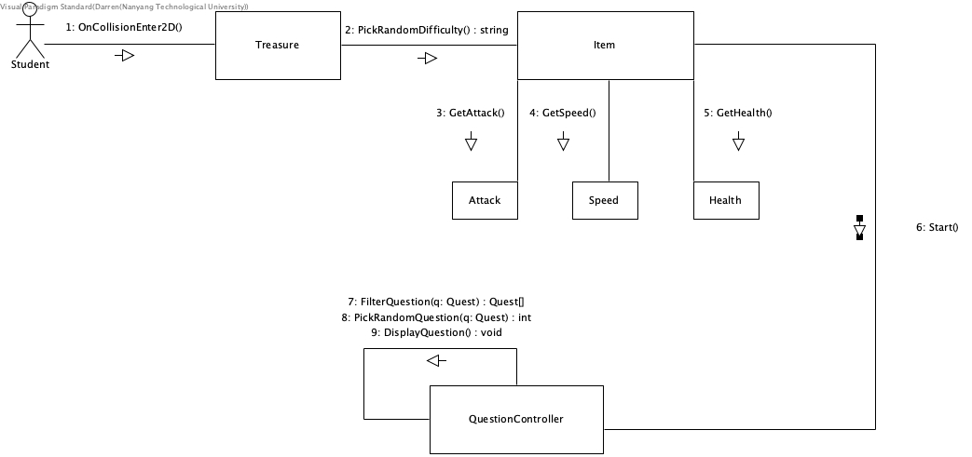
Communication Diagram

Slide 12
Use Case
Create Custom Quiz
Create customized questions and share it with other students.
Case 01
Case 03
Play Game
Case 02
View Report
Check learning progress by viewing the summarized game completion report .
Illustrate the process of getting through each stage.

Slide 13






Story Flow
How does
it work?
The creation of customized quizzes is known as custom lobby.
Creators can select up to 20 questions in a lobby.
Upon completion of custom lobby creation, URL link will be generated to be shared via social media.
Create lobby
Select Questions
Send Invitation
Voilà!

Slide 14
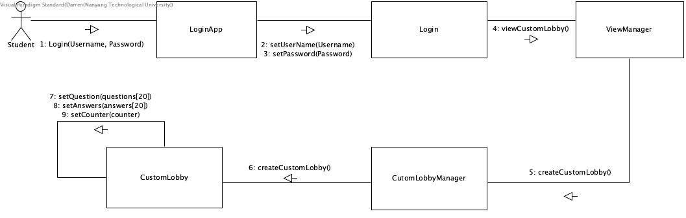
Communication Diagram

Slide 15
Use Case
Create Custom Quiz
Create customized questions and share it with other students.
Case 01
Case 03
Play Game
Case 02
View Report
Check learning progress by viewing the summarized game completion report .
Illustrate the process of getting through each stage.

Slide 16




Story Flow
How does
it work?
The summarized report is accessible to both students and teachers.
Student has limited access to his or her game progress report.
Select View Option
Enter Filter Criteria
View Report
Download Report

Slide 17
Software
Architecture

Slide 18
Core Architecture – Client Server
Advantages
Allow multiple players access
Shorten development time
Separation of client and server development
Ease of maintenance and database backup

Slide 19
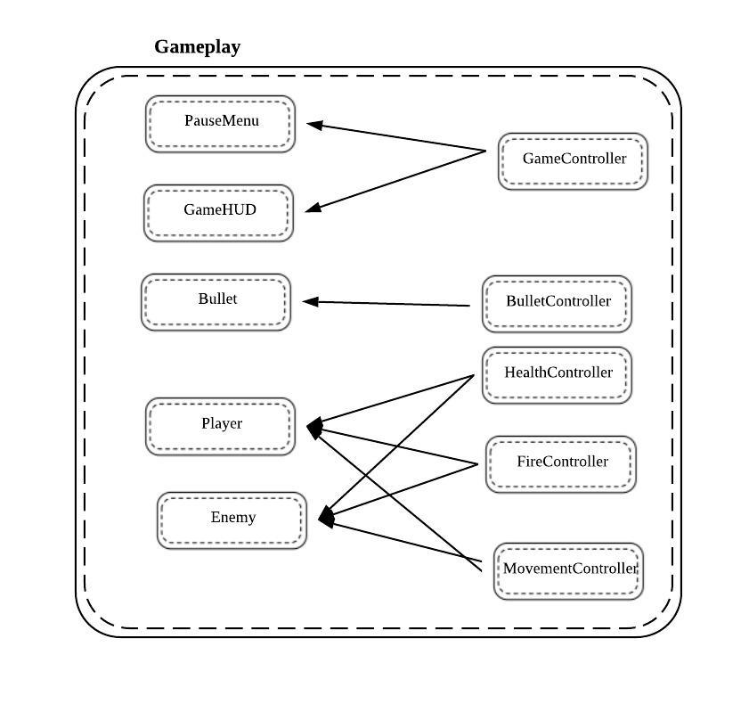
Subsystem 1 Architecture – Entity Component
Advantages
Common development model
Generation of reusable scripts to multiple entities

Slide 20
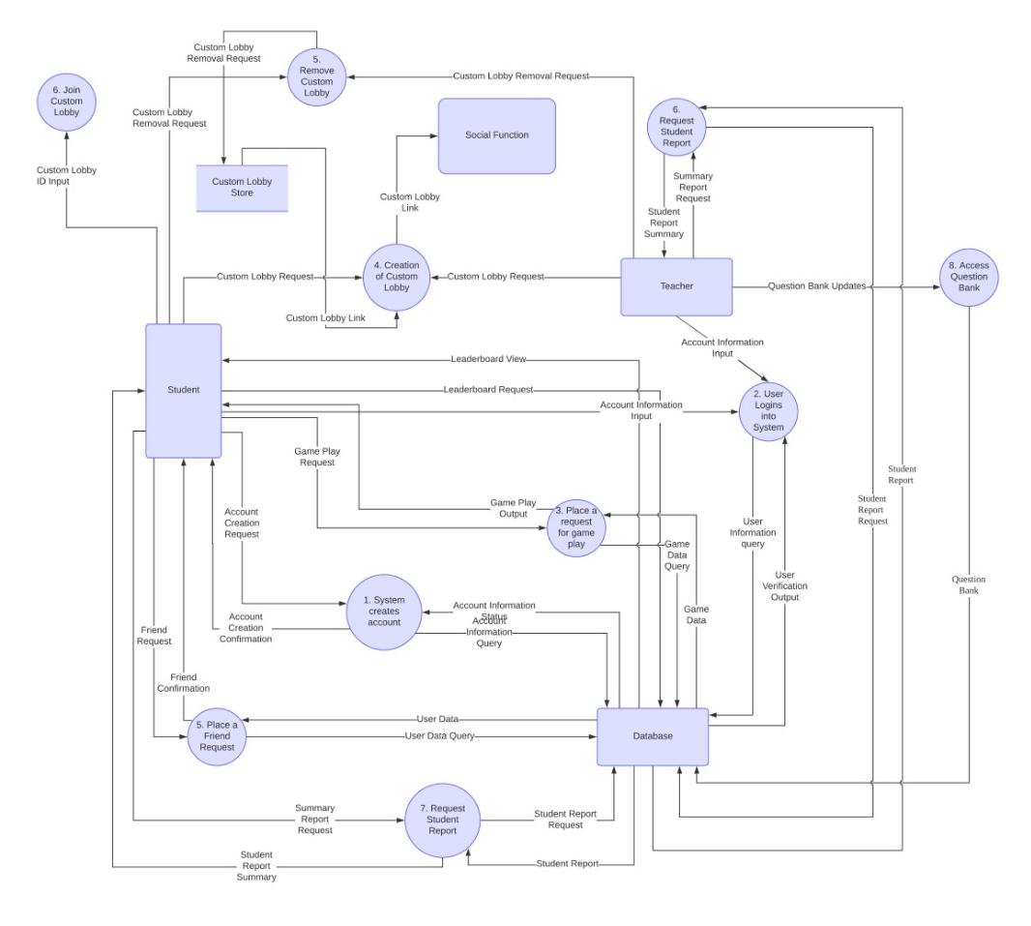
Data Flow Diagram

Slide 21



Quality Attributes
Usability
95% of users must grasp the basics of the game after the tutorial.
System provides feedback for every action the user takes
Performance
Average response time between click and reaction must be less than 0.5 seconds.
Transition between stages should be seamless, i.e. 0.5 seconds of load-time between stages
All game stages must be generated within 3 seconds when the player starts a new game
Flexibility
The student should be able to continue previous game progress if the user is registered with the system
The student must be able to access chat function to communicate with the other party in dual player mode.

Slide 22
Thank You For Playing

